Slide 1

INVENTORY MANAGEMENT SYSTEM (C PROGRAM)

Slide 2

INTRODUCTION
Inventory Management System is a menu-driven application developed using C programming language.This program helps in maintaining product details such as product ID, product name, quantity, and price in an organized manner.

Slide 3
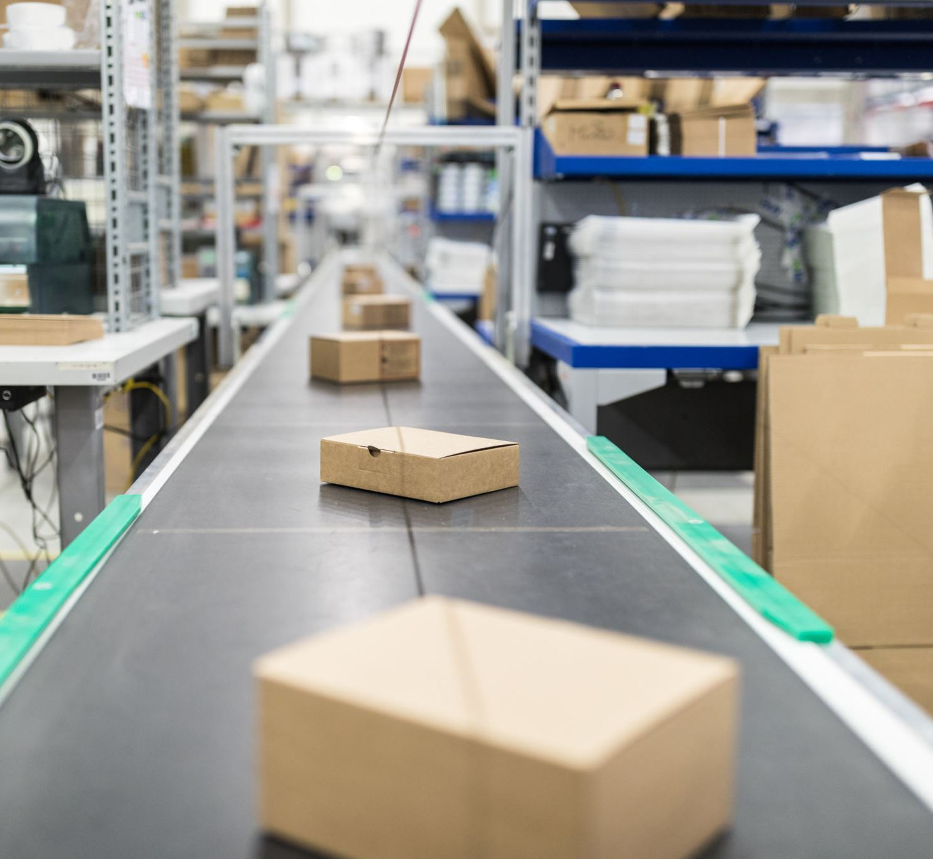
This program is designed to manage product information efficiently and reduce manual work.The system stores product details in a structured format.
Inventory management is an important task for any shop or business.

Slide 4

The program allows the user to perform different operations through a menu.It is suitable for small stores to keep track of available stock and sales

Slide 5
The program runs continuously until the user selects the exit option.It improves understanding of basic programming concepts in CIt helps users easily add new products and view existing product information

Slide 6
LOOPS USED IN THE CODE
The do-while loop is used to display the menu repeatedly until the user chooses to exit the program.The for loop is used to traverse through the list of products for viewing, updating stock, selling products, and checking low stock.
This program is to manage inventory in an easy and efficient way.It also helps students understand menu-driven programs and logical thinking in C.

Slide 7
VARIABLES USED IN THE CODE
Different variables are used to store product details, user input, and calculations.These variables help in controlling program flow, storing data, and generating the bill amount accurately.

Slide 8
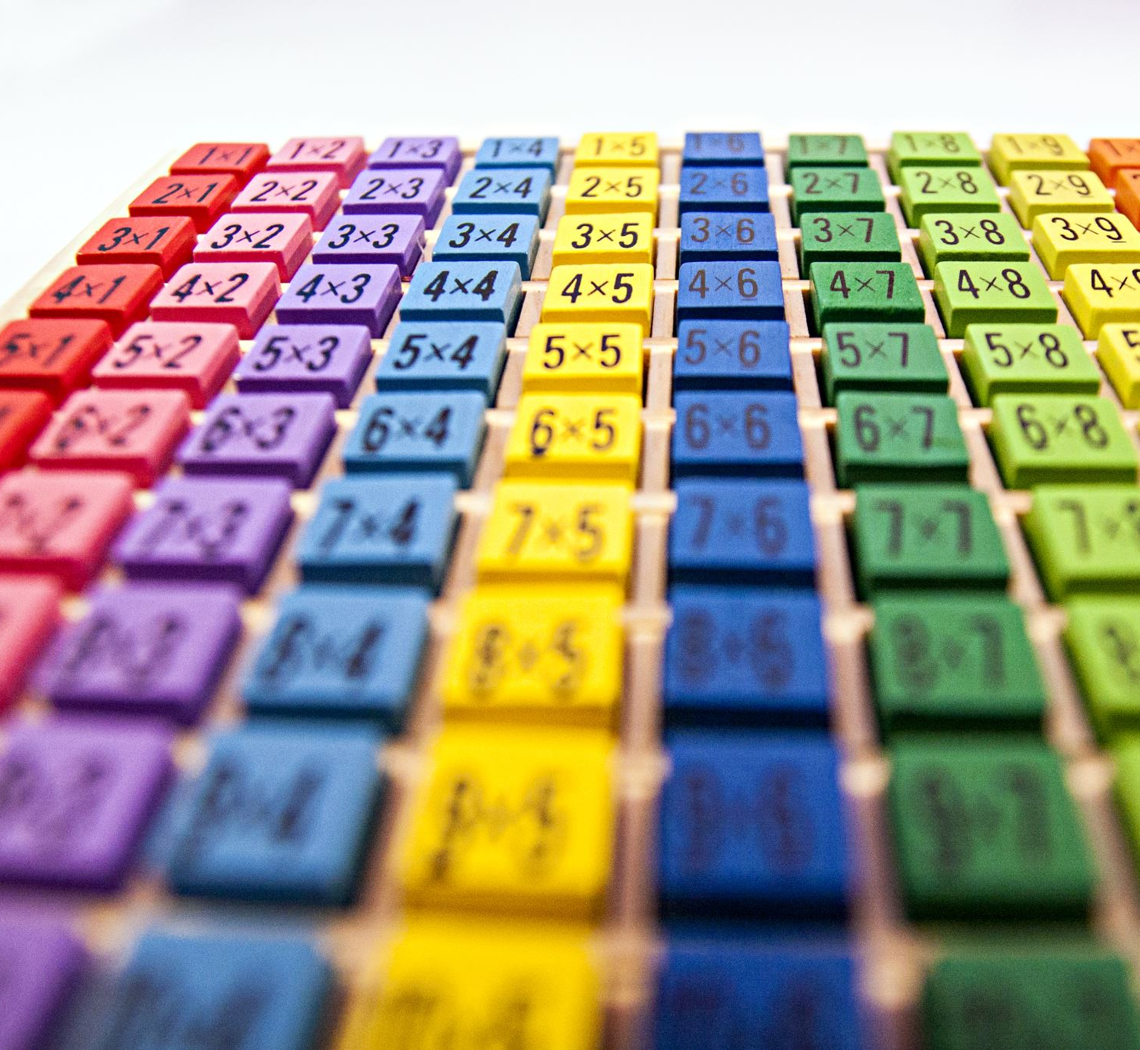
TOOLS AND CONCEPTS USED IN THE CODE
Arrays are used to store multiple product records.Structures are used to group related data like ID, name, quantity, and price.Loops and switch-case statements are used to perform repeated and conditional operations.

Slide 9

CONCLUSION
This Inventory Management System demonstrates the practical application of C programming.It is useful for learning structures, arrays, loops, and menu-driven programming concepts.

Slide 10
THANK YOU
Team Members
B.Kalyani. -25A31A04D1
B.H.S.Sri Lakshmi. -25A31A04D2
B.S.V.Sai Surya. -25A31A04G2
CH.Murali Krishna. -25A31A04G3

